Slide 1
Eagle Scout Service Project Troop / Committee Guide
Preparation for the Project Review
Seminole District / Central Florida Council / Seminole District Eagle Board
All items discussed in this presentation are intended to support and follow the Scouting America Guide to Advancement.
https://www.Scouting.org/resources/guide-to-advancement/

Slide 2
Getting Started
Once a Scout has earned the Rank of Life Scout then should be guided to take the following steps on their Trail to Eagle.
  Meet with their Scout Leader to map out the path forward.
    Review Scoutbook/Internet Advancement and verify all information is correct
    Review all Merit Badges are complete
    Verify all Position(s) of responsibility have been completed
    Make a plan to complete any Missing requirements
  Identify a Project Coach / Eagle Mentor / Eagle Advisor
    Help navigate the final requirements
    Help guide and advise on Eagle Proposal
    Project Coach should have understanding of the Project and Project Requirements.

Slide 3
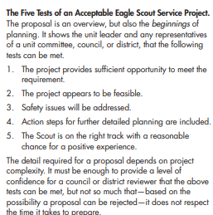
Helping a Scout Choose an Eagle Scout Service Project
Steps to Choosing a Successful Eagle Scout Service Project
  STEP 1 – Read the Eagle Scout Service Project Workbook
    Download the most current copy of the Service Project Workbook
    https://www.Scouting.org/programs/Scouts-bsa/advancement-and-awards/eagle-Scout-workbook/
    READ THE FIRST FIVE PAGES
  STEP 2 – Understand the Five Tests of an Acceptable Eagle Scout Service Project.
    The project provides sufficient opportunity to meet the requirement.
    The project appears to be feasible.
    Safety issues will be addressed.
    Action steps for further detailed planning are included.
    The Scout is on the right track with a reasonable chance for a positive
    experience
  STEP 3 – Coach helps prepare and reviews the Eagle Scout Service Project Proposal
The detail required for a proposal depends on Project complexity. It must be enough to provide a level of confidence for a council or district reviewer that the above tests can be met, but not so much that—based on the possibility a proposal can be rejected—it does not respect the time it takes to prepare.
Scouting America Guide to Advancement 2025 Section 9.0.2.7

Slide 4
Reviewing the
Eagle Scout Service Project
Workbook

Slide 5
Revieweing the proposal
The detail required for a proposal depends on project complexity. It must be enough to provide a level of confidence for a council or district reviewer that the 5 tests can be met.
Each question should provide enough detail that someone not familiar with the Scout or the Scout’s Project can understand what is trying to be accomplished.
Remember the District / Council is looking for a proposal that demonstrates the ability to meet Eagle Scout Requirement. To demonstrate this a Scout must Plan and Develop a Project that:
  allows the Scout to give leadership to others. The Scout must lead others in executing the work rather than completing it alone.
  has clear action steps that detail what needs to be done
  is beneficial to a religious institution, school, or community.
  is safe to be worked on by Scouts.
  be able to be executed in a timely manner with a reasonable chance for success.

Slide 6
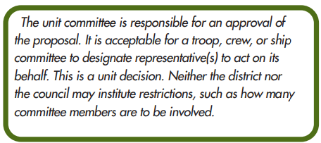
Unit Committee

Slide 7
9.0.2.0 The Eagle Scout Service Project
While a Life Scout, plan, develop, and give leadership to others in a service Project helpful to any religious institution, any school, or your community. (The Project must benefit an organization other than Scouting America.) A Project proposal must be approved by the organization benefiting from the effort, your unit leader and unit committee, and the council or district before you start. You must use the Eagle Scout Service Project Workbook, publication No. 512-927, in meeting this requirement.
—Eagle Scout requirement 5

Slide 8
The 5 Tests
The detail required for a proposal depends on Project complexity. It must be enough to provide a level of confidence for a council or district reviewer that the 5 tests can be met.
The project allows the Scout to give leadership to others. The Scout must lead others in executing the work rather than completing it alone.
The Project has clear action steps that detail what needs to be done
The Project iss beneficial to a religious institution, school, or community.
The Project can be done safely.
The Project can be able to be executed in a timely manner with a reasonable chance for success.
“One of the purposes for the Project is to demonstrate leadership, but this could be considered a more important element, perhaps, for Scouts who have not yet established themselves as leaders. It is for reasons like these that every project must be evaluated, case-by-case, on its merits, and on lessons that will advance the candidate’s growth.”
– Scouting America Guide to Advancement Section 9.0.2.4

Slide 9
9.0.2.14 Risk Management and Eagle Scout Service Projects
All Eagle Scout Service Projects constitute official Scouting activity and thus are subject to Scouting America policies and procedures. Projects are considered part of a unit’s program and are treated as such with regard to policies, procedures, and requirements regarding Youth Protection, two-deep leadership, etc.
Unit leadership should be aware of project plans and schedules. The health and safety of those working on Eagle projects must be integrated into project execution. Since an Eagle Scout Service Project is a unit activity, unit adult leadership has the same responsibility to assure safety in conducting a Project as with any other unit activity. The unit leader or unit committee should reject proposals for inherently unsafe projects. The candidate should plan for safe execution, but it must be understood that minors cannot and must not be held responsible for safety concerns. As with any Scouting activity, the Guide to Safe Scouting and all current Scouting America safety policies apply. See www.Scouting.org/health-and-safety/ guidelines-policies for current resources.

Slide 10
Red Flags for the Unit Committee
Troop Adults should help scouts recognize and resolve these issues before attending.
Eagle Scout Project Proposal Review
  Lack of Leadership Opportunities
  Safety Concerns
  Tight Timelines
  Significant knowledge / Skill / Ability Gap of Candidate to lead
  Required Approvals (Permits, Insurance Concerns, School Board Challenges)
Eagle Scout Boards of Review
  DO NOT
    Run practice Boards of Review
    Prepare the Scout for certain questions that may have been heard
    Promise Success
  PLEASE DO
    Remind the Scout that they have completed many Boards of Review
    Remind the Scout that this interview is about them and that they are ready
    Remind the Scout to have fun and enjoy the experience

Slide 11
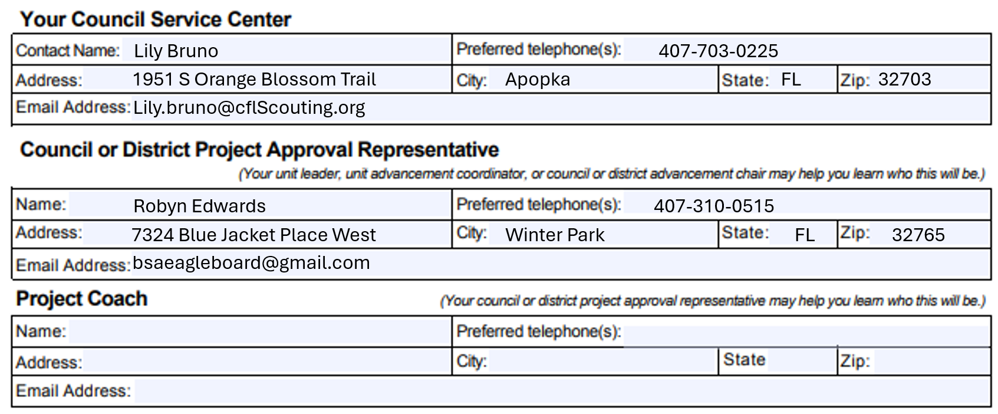
Points of Contact
Fill out all Eagle Scout Candidate information
Fill in all information on the Contacts Page
Project Coach is highly recommended and should be someone who can help you with your Project.
https://filestore.scouting.org/filestore/boyscouts/ppt/The-Eagle-Scout-Service-Project-Coach.pptx.

Slide 12
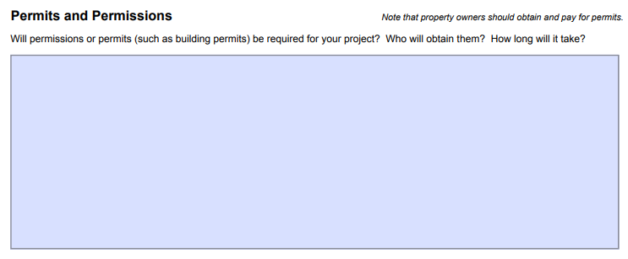
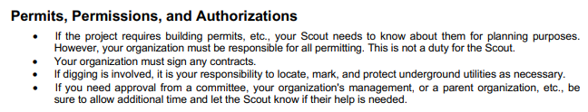
Permits and Permissions
All Projects require the permission of the beneficiary. Please supply who has approved this Project and their role in the organization.
If additional permits are required follow the guide notes below.

Slide 13
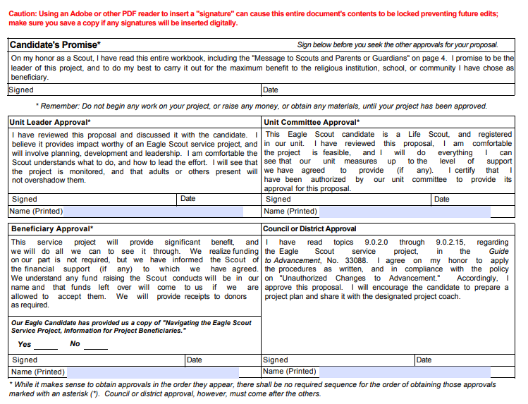
Signatures are Required!
Prior to signing, please check for red flags, POCs and that all forms are neat and complete.
Please make sure the Scout understands
An Eagle Scout Service Project Board of Review cannot be scheduled until all signatures have been received including the Beneficiary Approval.

Slide 14
Special Considerations
Please notify the District Eagle Board Chair or Admin of any special considerations needed to support the scout.
Examples include:
  Short time until scout reaches 18
  Time extension in place
  Personality to be aware of
  Medical concerns to be aware of
  Conflicts
Notification about special considerations are so that the board can make sure that we have the right people in place at the right time to support the scout. All special considerations will be handled discreetly by contacting the Eagle Board Chair or Eagle Board Admin Directly via bsaeagleboard@gmail.com

Slide 15
The District Eagle Scout Project
Board of Review

Slide 16
During the Project Review
Eagle Board:
1-3 Members will attend and question the candidate to assure the project meets the 5 tests
Troop Committee
1-2 Committee members will attend and support and question the candidate.
Project Coach
Optional but may attend to support the scout. The Coach cannot answer any questions unless directly asked.

Slide 17
What will be asked
What will be asked
  Scout will give a verbal brief overview of the Project.
  Provide details on how the Project demonstrates Planning and Leadership Skills.
  Has the Scout considered safety for the project?
  Does the Scout demonstrate the knowledge to successfully plan and execute the Project?
Reminders
  Follow the Guide to Safe Scouting
  Lead more than do.
  Start tracking volunteer hours and expenses
  Take pictures
  Plan to lead adults

Slide 18
Project Approval
Approval
  If the review board is satisfied that the Project meets the essential requirements for an Eagle Scout Service Project, the Board Chair will sign the District Approval section.
  The Scout may now move ahead with planning and completion of the Project
Not Approved / Postponed
  If the review board does not feel that the project meets the essential requirements then they can choose to “Postpone” or “Not Approve” the Project.
  The Scout can update the project to meet the requirements and re-submit, they can choose to submit a different Project, or they can appeal to the Council.

Slide 19
Other items that the Eagle Board looks for in projects

Slide 20
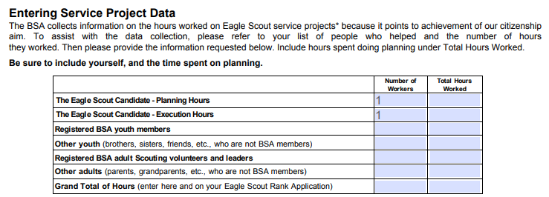
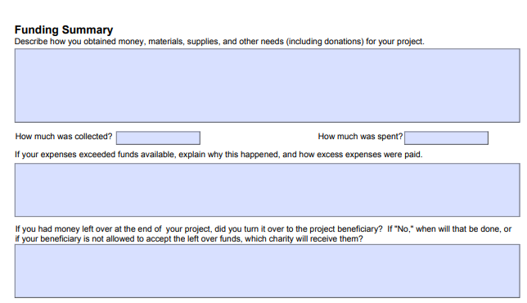
Tracking and Logs
The Eagle Scout Service Project Report requires tracking of hours and money. The Eagle board recommends that the Scout starts to keep track immediately to include all planning and proposal time.
Hours
  Create a log sheet that shows Who, What Was Done, and
  How Long it took.
  Include, emails, phone calls, conversations, driving time,
  store visits, everything that goes into planning and execution of this Project.
Money
  Keep records of money donated, earned at fundraisers, taken from Scout Accounts or donated by family.
  Keep receipts for everything that was spent. (Tracking sheets are in the Eagle Scout Service Project Plan.)

Slide 21
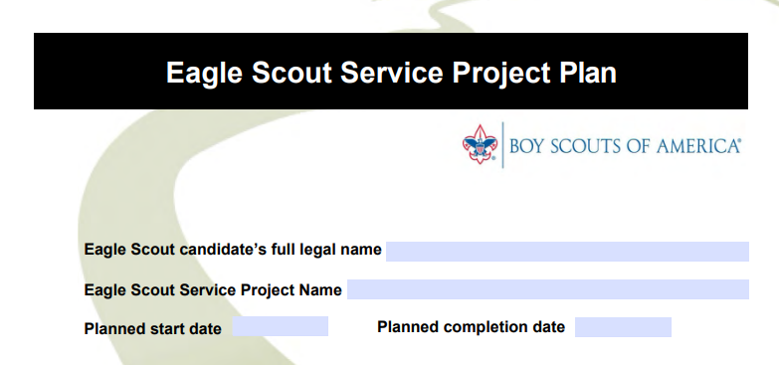
Eagle Scout Service Project Plan
This is not required prior to the Project Review.
However, it is highly encouraged that the Scout be familiar with this section as it will help with the review and completion of the Project.

Slide 22
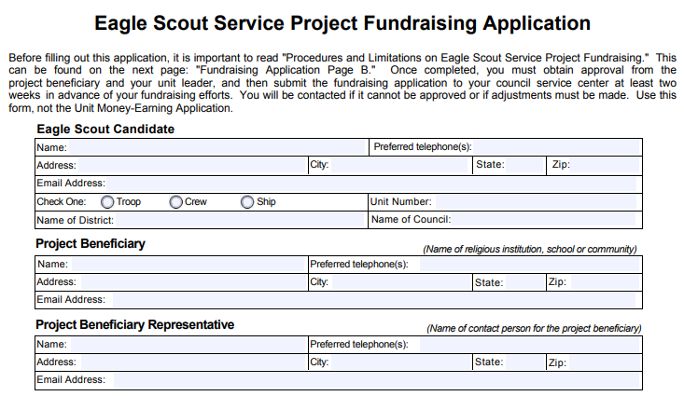
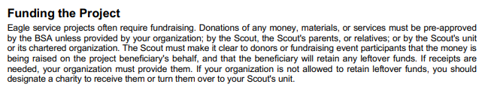
Project Fundraising
The Project Fundraising is not required for most Projects in the Central Florida Council.
If the Project is very expensive and requires a large amount of money or if the fundraising is like other fundraising that is done by the District or Council, the Scout should mention this for discussion during the Project Review as it may be required.
If the board determines the Fundraising Application to be required, it will need to be completed and signed prior to the start of fundraising.

Slide 23
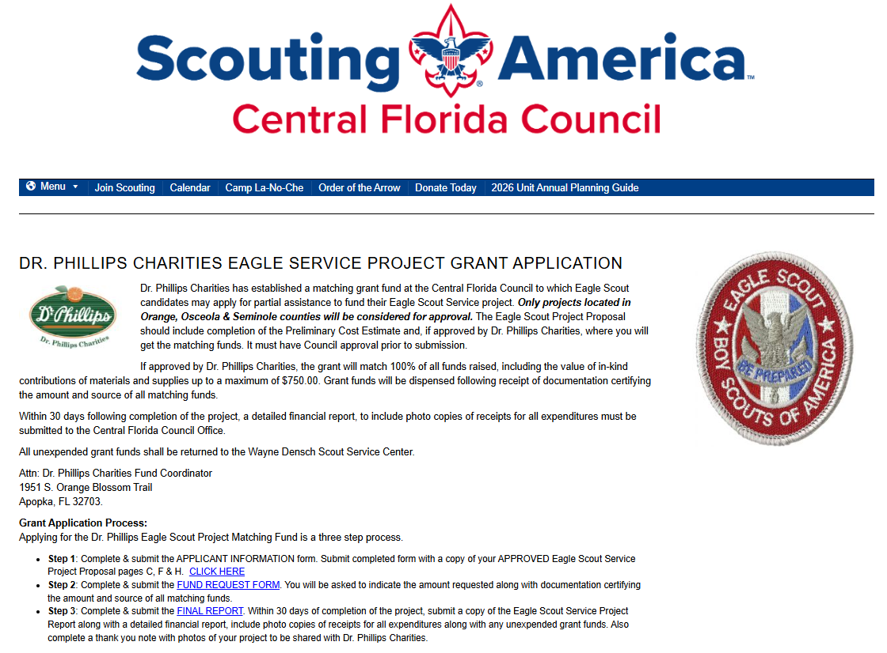
Dr. Philips Grant
https://www.cflscouting.org/dr-phillips-charities-eagle-service-project-grant-application/
If approved by Dr. Phillips Charities will grant:
Match 100% of all funds raised
Will be dispensed following receipt of
documentation of fund sources
Final report must be filed within 30 days of
completing the project, including photos,
copies of receipts etc.
All unexpended funds must be returned

Slide 24
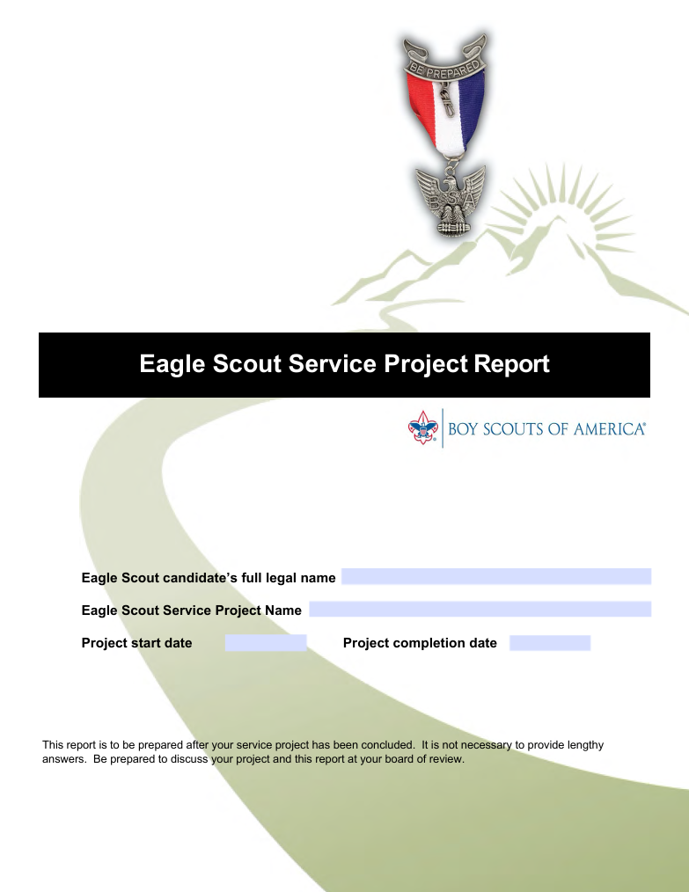
After Completing the Project
Complete the Eagle Scout Service Project Report
Collect all receipts, pictures and attendance sheets.
Review the “How to fill out your Eagle Scout Application” It walks you through how to fill out the application, line by line.

Slide 25
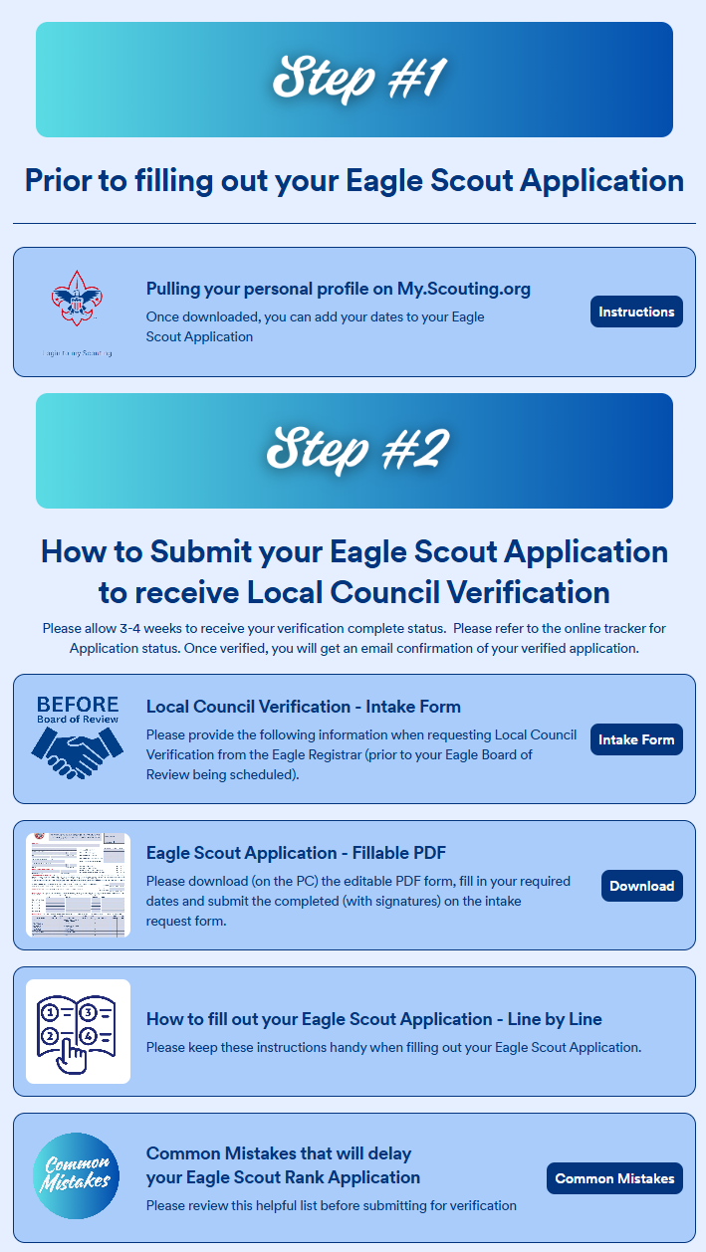
Step 7 – Submitting your Eagle Scout Application
Once the Eagle Candidate had completed the Project and all Eagle requirements the Scout may start the Eagle Scout Application Process
Eagle Scout Application Navigator Guide
Central Florida Council
https://app.jotform.com/242683781775168
Follow the instructions on the Eagle Scout Application Navigator to schedule your Eagle Board of Review.
  Once you have received your signed application back from Mrs. Bruno then Schedule your Eagle Board of Review.

Slide 26
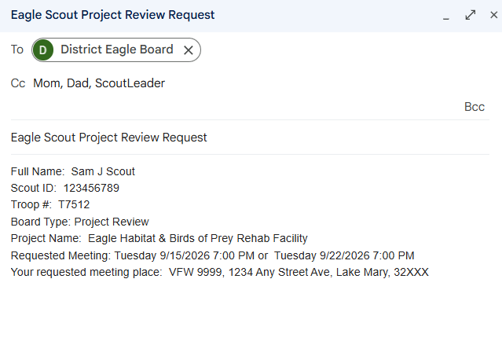
Schedule Eagle Board of Review
Send an email to:
bsaeagleboard@gmail.com
Please be sure to include the following information:
  Full Name:
  Scout ID:
  Troop #:
  Board Type: Eagle Board of Review
  Project Name:
  Requested Meeting: Day, Date, and Time
  ** Please provide 2 or 3 options
  Your requested meeting place:
If you have special circumstances – close to 18th birthday or moving
  *** Do not forget to include a parent, Project Coach and/or Scout Leader as required by the “Guide to Safe Scouting”. Otherwise, the board cannot respond to you.

