Slide 1
Eagle Scout Service Project Step by Step Guide
Preparation for the Project Review
Seminole District / Central Florida Council / Seminole District Eagle Board
All items discussed in this presentation are intended to support and follow the Scouting America Guide to Advancement.
https://www.Scouting.org/resources/guide-to-advancement/

Slide 2
Getting Started
Once a Scout has earned the Rank of Life Scout then should take the following steps on their Trail to Eagle.
  Meet with their Scout Leader to map out the path forward.
    Review Scoutbook/Internet Advancement and verify all information is correct
    Review all Merit Badges are complete
    Verify all Position(s) of responsibility have been completed
    Make a plan to complete any Missing requirements
  Identify a Project Coach / Eagle Mentor / Eagle Advisor
    Help navigate the final requirements
    Help guide and advise on Eagle Proposal
    Project Coach should have understanding of the Project and Project Requirements.

Slide 3
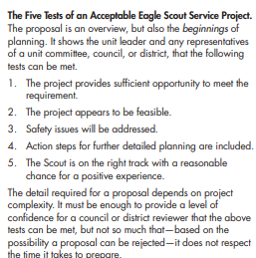
Choosing an Eagle Scout Service Project
Steps to Choosing a Successful Eagle Scout Service Project
  STEP 0 – Choose a Project Coach
  While a Coach is not required it is highly recommended and should be someone
  who is not a parent but has knowledge and understanding or what you want to do.
  STEP 1 – Read the Eagle Scout Service Project Workbook
    Download the most current copy of the Service Project Workbook
    https://www.Scouting.org/programs/Scouts-bsa/advancement-and-awards/eagle-Scout-workbook/
    READ THE FIRST FIVE PAGES with your parents and Project Coach
  STEP 2 – Understand the Five Tests of an Acceptable Eagle Scout Service Project.
    The project provides sufficient opportunity to meet the requirement.
    The project appears to be feasible.
    Safety issues will be addressed.
    Action steps for further detailed planning are included.
    The Scout is on the right track with a reasonable chance for a positive
    experience
  STEP 3 – Prepare the Eagle Scout Service Project Proposal
The detail required for a proposal depends on Project complexity. It must be enough to provide a level of confidence for a council or district reviewer that the above tests can be met, but not so much that—based on the possibility a proposal can be rejected—it does not respect the time it takes to prepare.
Scouting America Guide to Advancement 2025 Section 9.0.2.7

Slide 4
Eagle Scout Service Project
Workbook

Slide 5
Step 1 – Service Project Workbook
Download the EAGLE SCOUT SERVICE PROJECT WORKBOOK Scouting America requires that you use the current version of the workbook.
https://www.scouting.org/programs/scouts-bsa/advancement-and-awards/eagle-scout-workbook/
Save it to your computer.
For Naming the file we recommend using a format like this where ‘t’ is your 4 digit Troop number and BSA PID #:
Lastname-FirstInitial-t0000-BSAPID# | For example: Scout-J-T0057-123456789
Recommendation – It is recommended to prepare the information for the Service Project workbook in a tool like Word. This can help prevent data loss as well as help with grammar, spelling and punctuation. Then cut and past the answers into the Workbook. (This is optional but can help.)
** While spelling and punctuation will not hold up a proposal neatness and attention to details counts. Think of this like a college application or job application.
We do not recommend filling it out online or in a web browser.

Slide 6
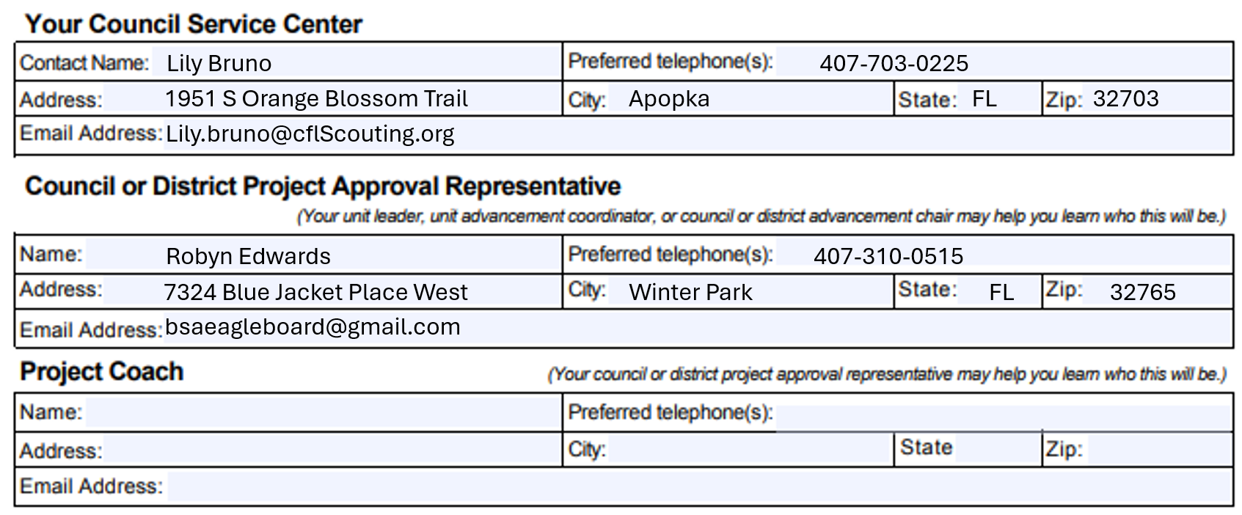
Step 2 – Contact Information
Fill out all Eagle Scout Candidate information
Fill in all information on the Contacts Page
Project Coach is highly recommended and should be someone who can help you with your Project.
https://filestore.scouting.org/filestore/boyscouts/ppt/The-Eagle-Scout-Service-Project-Coach.pptx.

Slide 7
Step 3 - Filling out the rest of the proposal
The detail required for a proposal depends on project complexity. It must be enough to provide a level of confidence for a council or district reviewer that the 5 tests can be met.
Answer each question with enough detail that someone not familiar with the Scout or the Scout’s Project can understand what is trying to be accomplished.
Remember the Troop Committee and District Board are looking for a proposal that demonstrates the ability to meet Eagle Scout Requirement. To demonstrate this a Scout must Plan and Develop a Project that:
  allows the Scout to give leadership to others. The Scout must lead others in executing the work rather than completing it alone.
  has clear action steps that detail what needs to be done
  is beneficial to a religious institution, school, or community.
  is safe to be worked on by Scouts.
  be able to be executed in a timely manner with a reasonable chance for success.

Slide 8
The 5 Tests
The detail required for a proposal depends on Project complexity. It must be enough to provide a level of confidence for a council or district reviewer that the 5 tests can be met.
The project allows the Scout to give leadership to others. The Scout must lead others in executing the work rather than completing it alone.
The Project has clear action steps that detail what needs to be done
The Project iss beneficial to a religious institution, school, or community.
The Project can be done safely.
The Project can be able to be executed in a timely manner with a reasonable chance for success.
“One of the purposes for the Project is to demonstrate leadership, but this could be considered a more important element, perhaps, for Scouts who have not yet established themselves as leaders. It is for reasons like these that every project must be evaluated, case-by-case, on its merits, and on lessons that will advance the candidate’s growth.”
– Scouting America Guide to Advancement Section 9.0.2.4

Slide 9
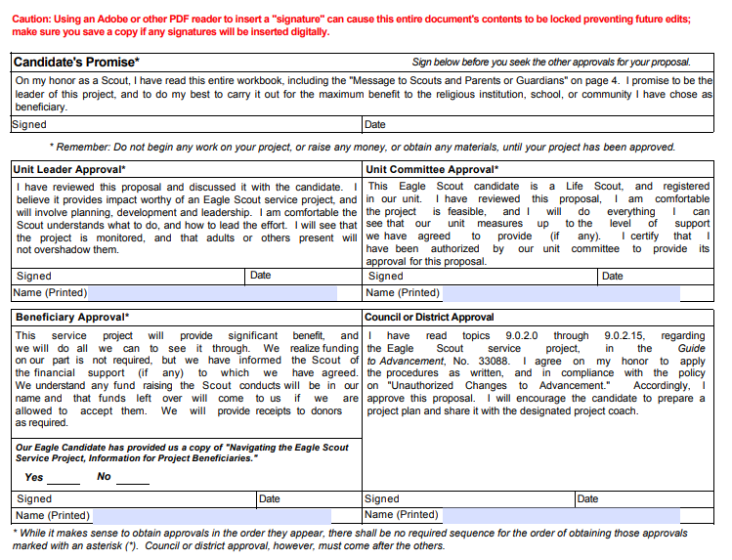
Step 4 - Signatures are Required!
Please DO NOT schedule an Eagle Scout Service Project Board of Review until all the following have been signed and dated.
Candidate Promise
Unit Leader Approval
Unit Committee Approval
Beneficiary Approval

Slide 10
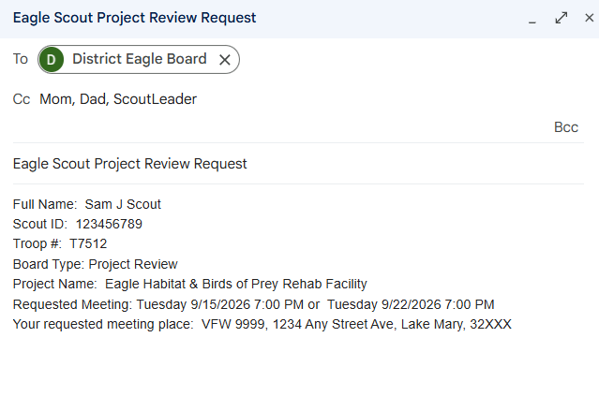
Step 5 - Schedule Proposal Review
Send an email to:
bsaeagleboard@gmail.com
Please be sure to include the following information:
  Full Name:
  Scout ID:
  Troop #:
  Board Type: Project Review
  Project Name:
  Requested Meeting: Day, Date, and Time
  ** Please provide 2 or 3 options
  Your requested meeting place:
Please notify the board ASAP if you have special circumstances – close to 18th birthday or moving
  *** Do not forget to include a parent, Project Coach and/or Scout Leader as required by the “Guide to Safe Scouting”. Otherwise, the board cannot respond to you.

Slide 11
Special Considerations
When scheduling a board of review please notify the board of any special considerations to support the scout.
Examples include:
  Short time until scout reaches 18
  Time extension in place
  Personality to be aware of
  Medical concerns to be aware of
  Conflicts
Notification about special considerations are so that the board can make sure that we have the right people in place at the right time to support the scout. All special considerations will be handled discreetly by contacting the Eagle Board Chair or Eagle Board Admin Directly via bsaeagleboard@gmail.com

Slide 12
The District Eagle Scout Project
Board of Review

Slide 13
Be Prepared
Scout should be prepared
  Arrive on Time
  Completed Project Proposal with all wet signatures (marked as ORIGINAL)
  ** We recommend parties sign in blue ink.
  Bring all of your supporting documentation (Fundraiser Information, drawings, pictures, hour log and anything else)
  Bring TWO additional completed copies of your paperwork.
  Pen and Notebook or your own copy of the proposal to take notes
  Please come in your full Scout Field Uniform (as your unit defines it)
  If for some reason you cannot come in uniform, we trust you will be neat in appearance

Slide 14
During the Project Review
Talk about how you will show leadership.
Pay attention to details
Take notes (Bring Paper and Pen)
Ask questions if you're not sure
Have fun.

Slide 15
What will be asked
What will be asked
  Scout will give a verbal brief overview of the Project.
  Provide details on how the Project demonstrates Planning and Leadership Skills.
  Has the Scout considered safety for the project?
  Does the Scout demonstrate the knowledge to successfully plan and execute the Project?
Reminders
  Follow the Guide to Safe Scouting
  Lead more than do.
  Start tracking volunteer hours and expenses
  Take pictures
  Plan to lead adults

Slide 16
Project Approval
Approval
  If the review board is satisfied that the Project meets the essential requirements for an Eagle Scout Service Project, the Board Chair will sign the District Approval section.
  The Scout may now move ahead with planning and completion of the Project
Not Approved / Postponed
  If the review board does not feel that the project meets the essential requirements then they can choose to “Postpone” or “Not Approve” the Project.
  The Scout can update the project to meet the requirements and re-submit, they can choose to submit a different Project, or they can appeal to the Council.

Slide 17
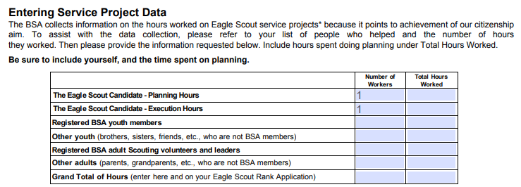
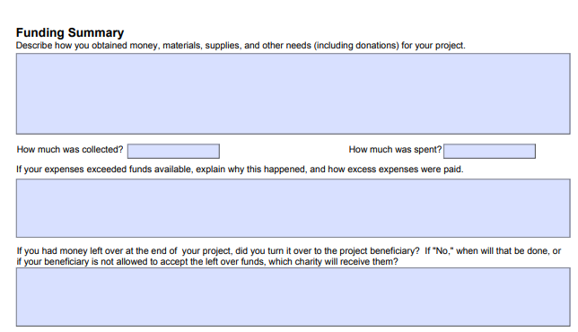
Tracking and Logs
The Eagle Scout Service Project Report requires tracking of hours and money. The Eagle board recommends that the Scout starts to keep track immediately to include all planning and proposal time.
Hours
  Create a log sheet that shows Who, What Was Done, and
  How Long it took.
  Include, emails, phone calls, conversations, driving time,
  store visits, everything that goes into planning and execution of this Project.
Money
  Keep records of money donated, earned at fundraisers, taken from Scout Accounts or donated by family.
  Keep receipts for everything that was spent. (Tracking sheets are in the Eagle Scout Service Project Plan.)

Slide 18
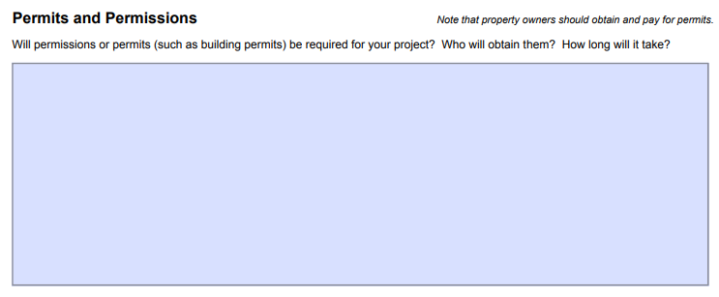
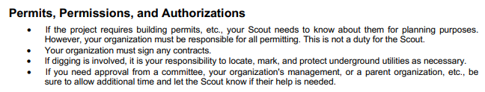
Permits and Permissions
All Projects require the permission of the beneficiary. Please supply who has approved this Project and their role in the organization.
If additional permits are required follow the guide notes below.

Slide 19
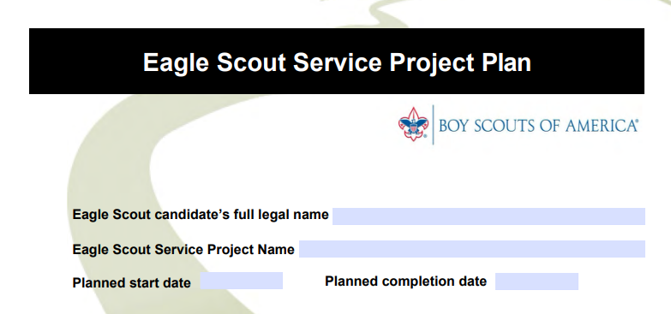
Eagle Scout Service Project Plan
This is not required prior to the Project Review.
However, it is highly encouraged that the Scout be familiar with this section as it will help with the review and completion of the Project.

Slide 20
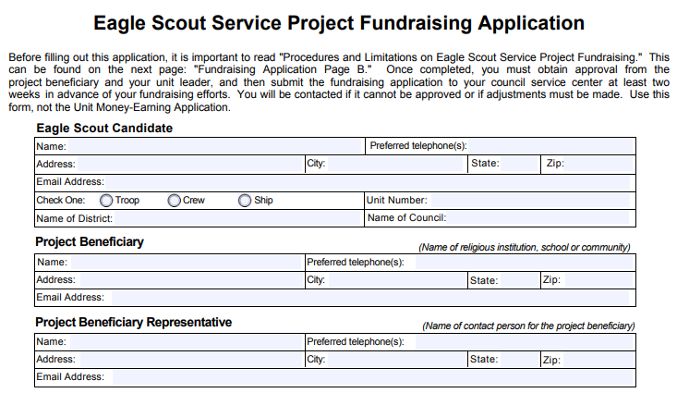
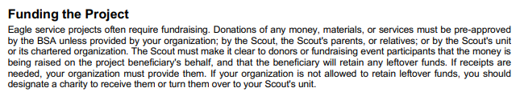
Project Fundraising
The Project Fundraising is not required for most Projects in the Central Florida Council.
If the Project is very expensive and requires a large amount of money or if the fundraising is like other fundraising that is done by the District or Council, the Scout should mention this for discussion during the Project Review as it may be required.
If the board determines the Fundraising Application to be required, it will need to be completed and signed prior to the start of fundraising.

Slide 21
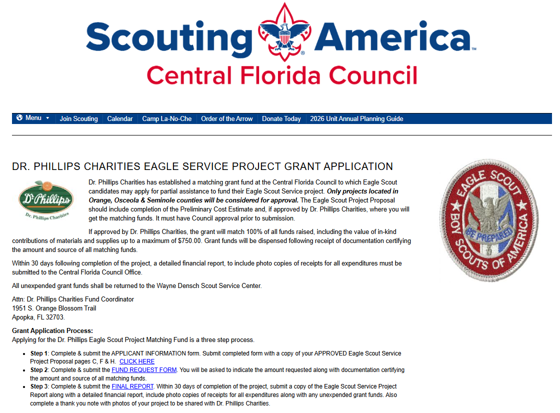
Dr. Philips Grant
https://www.cflscouting.org/dr-phillips-charities-eagle-service-project-grant-application/
If approved by Dr. Phillips Charities will grant:
Match 100% of all funds raised
Will be dispensed following receipt of
documentation of fund sources
Final report must be filed within 30 days of
completing the project, including photos,
copies of receipts etc.
All unexpended funds must be returned

Slide 22
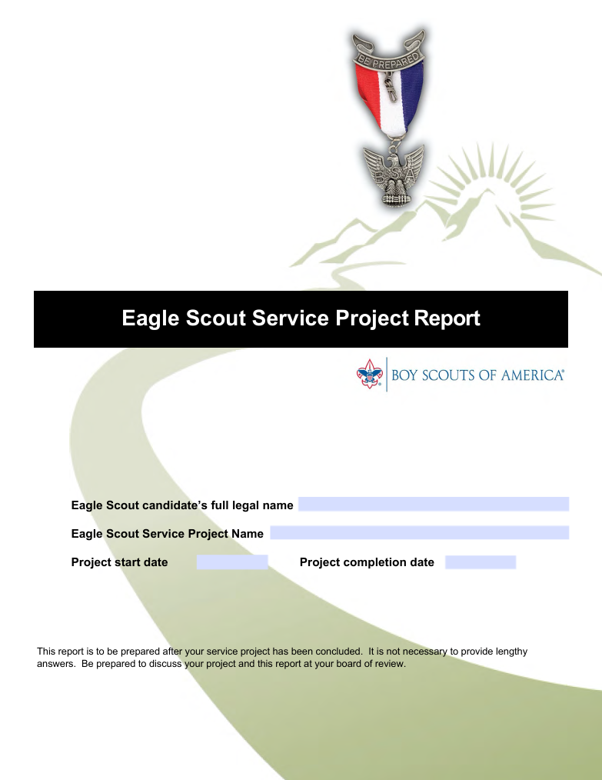
Step 6 – After Completing the Project
Complete the Eagle Scout Service Project Report
Collect all receipts, pictures and attendance sheets.
Review the “How to fill out your Eagle Scout Application” It walks you through how to fill out the application, line by line.

Slide 23
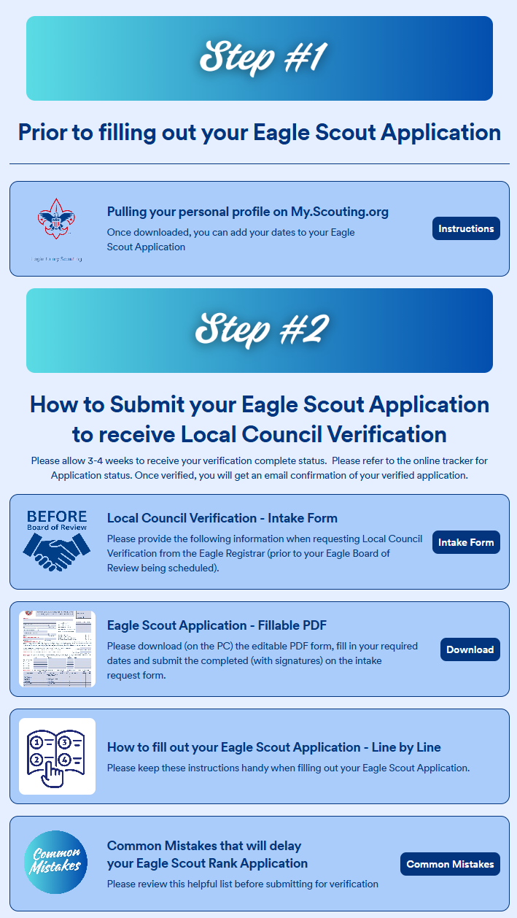
Step 7 – Submitting your Eagle Scout Application
Once the Eagle Candidate had completed the Project and all Eagle requirements the Scout may start the Eagle Scout Application Process
Eagle Scout Application Navigator Guide
Central Florida Council
https://app.jotform.com/242683781775168
Follow the instructions on the Eagle Scout Application Navigator to schedule your Eagle Board of Review.
  Once you have received your signed application back from Mrs. Bruno then Schedule your Eagle Board of Review.

Slide 24
Step 8 - Schedule Eagle Board of Review
Send an email to:
bsaeagleboard@gmail.com
Please be sure to include the following information:
  Full Name:
  Scout ID:
  Troop #:
  Board Type: Eagle Board of Review
  Project Name:
  Requested Meeting: Day, Date, and Time
  ** Please provide 2 or 3 options
  Your requested meeting place:
If you have special circumstances – close to 18th birthday or moving
  *** Do not forget to include a parent, Project Coach and/or Scout Leader as required by the “Guide to Safe Scouting”. Otherwise, the board cannot respond to you.

